Slide 1

UNIT-3
LINED LISTS
LINKED LISTS
LINKED LISTS
LINKED LIST

Slide 2
UNIT -3
  Singly Linked List
  Doubly Linked List
  Circular Linked List
  Representing Stack with Linked List.
  Representing Queue with Linked List.

Slide 3
LINKED LIST

Slide 4
LIST
List of Similar data item
Ex: shopping list
or
Student List
Implementation :
Lists can be implemented by Arrays.
Y we need Linked lists?

Slide 5
Arrays
The size of the array is fixed.
Once memory is allocated, it cannot be extended/shrink any more. So that array is called the static data structure.
Elements are stored in consecutive memory locations.
To occupy the adjacent space, block of memory that is required for the array should be allocated before hand.
Wastage of memory is more in arrays.
Inserting new element at the front is potentially expensive because existing elements need to be shifted over to make space.
But, Linked list is a dynamic data structure, it is able to grow/shrink in size as needed.
LL is STRONG where Array is Weak

Slide 6
THAT’S Y
We implement Linked Lists with Dynamic Data Structure.
Dynamic data structures
  Data structures that grow and shrink during execution

Slide 7

What is Linked List?
A linked list is a linear collection of homogeneous data elements,
called nodes, where linear order is maintained by means of links or pointers.
Each node has two parts:
  The first part contains the data (information of the element) and
  The second part contains the address of the next node (link /next pointer field) in the list.
Data part of the link can be an integer,
a character, a String or an object of any kind.
A
data
pointer

Slide 8
node
link
data
Start
Null
A
B
C
D

Slide 9
Linked Lists
Linked list
  Linear collection of self-referential structures, called nodes, connected by pointer links.
  Accessed via a pointer to the first node of the list.
  Subsequent nodes are accessed via the link-pointer member stored in each node.
  Link pointer in the last node is set to null to mark the end of list.
  Data stored dynamically – each node is created as necessary.
  Length of a list can increase or decrease.
  A node can contain data of any type including other struct objects.
  Becomes full only when the system has insufficient memory to satisfy dynamic storage allocation requests.

Slide 10
Linked list Advantages
1. Linked list are dynamic data structure. That is, they can grow or shrink during
the execution of a program.
2. Efficient memory utilization: In linked list (or dynamic) representation, memory is not pre-allocated. Memory is allocated whenever it is required. And it is deal located (or removed) when it is not needed
3. Insertion and deletion are easier and efficient. Linked list provides flexibility in inserting a data item at a specified position and deletion of a data item from the given position.
Many complex applications can be easily carried out with linked list..
Linked list Disadvantages
1. More memory: to store an integer number, a node with integer data and address field is allocated. That is more memory space is needed.
2. Access to an arbitrary data item is little bit cumbersome and also time consuming.

Slide 11
Types of linked lists
  Singly linked list
    Begins with a pointer to the first node
    Terminates with a null pointer
    Only traversed in one direction
  Circular, singly linked list
    Pointer in the last node points back to the first node
  Doubly linked list
    Two “start pointers”- first element and last element
    Each node has a forward pointer and a backward pointer
    Allows traversals both forwards and backwards
  Circular, doubly linked list
    Forward pointer of the last node points to the first node and backward pointer of the first node points to the last node

Slide 12
Dynamic Memory Allocation
Dynamic memory allocation
  Obtain and release memory during execution
malloc
  Takes number of bytes to allocate
    Use sizeof to determine the size of an object
  Returns pointer of type void *
    A void * pointer may be assigned to any pointer
    If no memory available, returns NULL
  newPtr = malloc( sizeof( struct node ) );
free
  Deallocates memory allocated by malloc
  Takes a pointer as an argument
  free (newPtr);

Slide 13
MALLOC FUNCTION
malloc() function is used for allocating block of memory at runtime. This function reserves a block of memory of given size and returns a pointer of type void. This means that we can assign it to any type of pointer using typecasting. If it fails to locate enough space it returns a NULL pointer.

Slide 14
Self-Referential Structures
Self-referential structures
  Structure that contains a pointer to a structure of the same type
  Can be linked together to form useful data structures such as lists, queues, stacks and trees
  Terminated with a NULL pointer (0)
Two self-referential structure objects linked together
15
10
Data member and pointer
NULL pointer (points to nothing)

Slide 15
Singly linked lists
Node Structure
struct node
{
int data;
struct node *link;
}*new, *ptr, *header, *ptr1;
2000
new
data
link
10
NULL
Creating a node
new = malloc (sizeof(struct node));
Read item
new -> data = item;
new -> link = NULL;
2000

Slide 16
Inserting a node at the beginning
Create a node that is to be inserted
if (header = = NULL)
new -> link = NULL;
header = new;
else
{
new -> link = header;
header = new;
}
2500
new
data
link
10
NULL
2500
If the list is empty
NULL
header
header
If the list is not empty
1200
2500
header
new
5
1300
5
1330
4
1400
8
NULL
10
NULL
1200
1300
1330
1400
2500

Slide 17
Inserting a node at the end
header
1500
10
1800
20
1200
30
1400
40
NULL
2000
1500
1400
1800
1200
ptr
50
NULL
1400
1800
1500
1200
2000
ptr = header;
while(ptr -> link!= NULL)
ptr = ptr -> link;
new -> link = NULL;
ptr -> link = new;
new
2000

Slide 18
Inserting a node at the given position
header
ptr
1800
1500
1500
Insert position : 3
10
1800
20
1200
2000
30
1400
40
NULL
1500
1400
1800
1200
50
NULL
1200
new
ptr = header;
for(i=1;i < pos-1;i++)
ptr = ptr -> link;
new -> link = ptr -> link;
ptr -> link = new;
2000
2000

Slide 19
Deleting a node at the beginning
header
ptr
1500
1500
1800
10
1800
20
1200
30
1400
40
NULL
1500
1400
1800
1200
if (header = = NULL)
print “List is Empty”;
else
{
ptr = header;
print deleted item is ptr->data
header = header -> link;
free(ptr);
}

Slide 20
Deleting a node at the end
header
ptr1
ptr1
ptr1
1500
10
1800
20
1200
30
NULL
1400
40
NULL
1500
1400
1800
1200
ptr
1800
1200
1400
1500
ptr = header;
while(ptr -> link != NULL)
{
ptr1=ptr;
ptr = ptr -> link;
}
Print deleted item is ptr->data
ptr1 -> link = NULL;
free(ptr);

Slide 21
Deleting a node at the given position
ptr1
header
ptr
1200
1800
1500
1500
Insert position : 3
10
1800
20
1400
1200
30
1400
40
NULL
1500
1400
1800
1200
ptr = header;
for(i=1;i<pos;i++)
{ ptr1 = ptr ;
ptr = ptr -> link;
}
print deleted item is ptr->data
ptr1 -> link = ptr-> link;
free(ptr);

Slide 22
Traversing an elements of a list
header
ptr
1500
1500
10
1800
20
1200
30
1400
40
NULL
1500
1800
1200
1400
if(header = = NULL)
print “List is empty”;
else
for (ptr = header ; ptr != NULL ; ptr = ptr -> link)
print “ptr->data”;

Slide 23
#include<stdio.h>
#include<stdlib.h>
void traverse();
void deletion();
void insertion();
void search();
int ch,i,pos,item;
struct node
{
int data;
struct node *link;
}*header,*ptr,*ptr1,*new;

Slide 24
void main()
{
header=NULL;
while(1)
{
printf("****Menu****\n");
printf("\n 1.Insertion\n 2.Deletion\n 3.Traverse\n 4.Search\n 5.Exit\n");
printf("\nenter ur choice");
scanf("%d",&ch);
switch(ch){
case 1: insertion();
break;
case 2: deletion();
break;
case 3: traverse();
break;
case 4: search();
break;
case 5: exit(0);
default: printf("\nwrong choice\n");
}
}
}

Slide 25
void insertion()
{
ptr=header;
new=malloc(sizeof(struct node));
printf("\n enter the item to be inserted\n");
scanf("%d",&item);
new->data=item;
if(header==NULL)
{
new->link=NULL;
header=new;
} /*end of if*/

Slide 26
else
{
printf("\nEnter the place to insert the item\n");
printf("1.Start\n 2.Middle\n 3.End\n");
scanf("%d",&ch);
if(ch==1)
{
new->link=header;
header=new; }
if(ch==2)
{
printf("Enter the position to place an item: ");
scanf("%d",&pos);
for(i=1;i<pos-1;i++)
ptr=ptr->link;
new->link=ptr->link;
ptr->link=new;
}
if(ch==3)
{
while(ptr->link!=NULL)
ptr=ptr->link;
new->link=NULL;
ptr->link=new;
}//end of if
}/*end of else*/
}/*end of insertion

Slide 27
void deletion()
{
ptr=header;
if(header==NULL)
{
printf("\nThe list is empty");
}
else if(ptr->link==NULL)
{ printf(“deleted item is -> %d”,ptr->data); free(ptr);
header=NULL;
}
else
{
printf("\n1.Start \n2.Middle \n3.End");
printf("\nEnter the place to delete the element from list");
scanf("%d",&ch);
if(ch==1)
{
printf("\nThe deleted item from the list is -> %d",ptr->data);
header=header->link;
free(ptr);
}

Slide 28
if(ch==2){
printf("\nEnter the position to delete the element from the list");
scanf("%d",&pos);
for(i=1; i<pos; i++)
{
ptr1=ptr; ptr=ptr->link;
}
printf("\nThe deleted element is ->%d",ptr->data);
ptr1->link=ptr->link;
free(ptr);
}
if(ch==3){
while(ptr->link!=NULL)
{
ptr1=ptr; ptr=ptr->link;
}
printf("\nThe deleted element from the list is ->%d", ptr->data);
ptr1->link=NULL;
free(ptr);
}
}/*end of else*/
}/*end of deletion*/

Slide 29
void search()
{
int loc=0,f=0;
printf("\nEnter the element to be searched in the list");
scanf("%d",&item);
for(ptr=header;ptr!=NULL;ptr=ptr->link)
{
loc++;
if(ptr->data==item)
{
f=1; break; }
}
if(f==0)
printf("\nElement not found");
else
printf("\nThe element found at location %d",loc);
}/*end of search*/

Slide 30
void traverse()
{
if(header==NULL)
printf("List is empty\n");
else
{
printf("\nThe elements in the list are");
for(ptr=header;ptr!=NULL;ptr=ptr->link)
printf(“ %d”,ptr->data);
}
}/*end of traverse*/

Slide 31
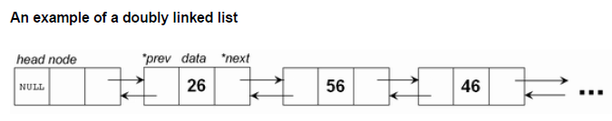
Doubly linked list
In a singly linked list one can move from the header node to any node in one direction only (left-right).
A doubly linked list is a two-way list because one can move in either direction. That is, either from left to right or from right to left.
It maintains two links or pointer. Hence it is called as doubly linked list.
Where, DATA field - stores the element or data, PREV- contains the address of its previous node, NEXT- contains the address of its next node.
PREV DATA NEXT
Structure of the node

Slide 32
Doubly linked list operations
Insertion:
Insertion of a node at the front
Insertion of a node at any position in the list
Insertion of a node at the end
Deletion:
Deletion at front
Deletion at any position
Deletion at end
Display:
Displaying/Traversing the elements of a list

Slide 33
ptr
header
Before inserting a node at the beginning
1010
1010
NULL
10
2020
1010
20
1000
2020
30
2000
1000
40
NULL
1010
2020
1000
2000
NULL
50
NULL
2200
new
After inserting a node at the beginning
2200
10
2020
1010
20
1000
2020
30
2000
1000
40
NULL
1010
2020
1000
2000
Algorithm
Create a new node
Read the item
new->data=item
ptr= header
new->next=ptr;
new->prev=NULL;
ptr->prev=new;
header=new;
NULL
50
1010
2200
new
header
2200

Slide 34
header
Before inserting a node at end of a list
ptr
1010
1010
ptr
NULL
10
2020
1010
20
1000
2020
30
2000
1000
40
NULL
1010
2020
1000
2000
NULL
50
NULL
After inserting a node
at end of a list
ptr
2000
2200
new
NULL
10
2020
1010
20
1000
2020
30
2000
1000
new
40
2200
1010
2020
1000
2000
Algorithm:
Create a new node
Read the item
new->data=item
ptr= header
while(ptr->next!=NULL)
  ptr=ptr->next;
new->next=NULL;
new->prev=ptr;
ptr->next=new;
2000
50
NULL
2200
new

Slide 35
Insertion of a node at any position in the list
Algorithm
1. create a node new
2. read item
3. new->data=item
4. ptr=header;
5. Read the position where the element is to be inserted
6. for(i=1;i<pos-1;i++)
6.1 ptr=ptr->next;
7.
7.1 ptr1=ptr->next;
7.2 new->next=ptr1;
7.3 new->prev=ptr;
7.3 ptr1->prev=new;
7.4 ptr->next=new;
9. end

Slide 36
header
ptr
Before inserting a node at position 3
1010
1010
ptr
NULL
10
2020
1010
20
1000
2020
30
2000
1000
40
NULL
1010
2020
1000
2000
NULL
50
NULL
2200
new
After inserting a node at position 3
ptr
2020
ptr
ptr
header
1000
ptr1
1010
NULL
10
2020
1010
20
2200
2200
30
2000
1000
40
NULL
1010
2020
1000
2000
2020
50
1000
2200
new

Slide 37
header
1010
Before deleting a node at beginning
NULL
10
2020
1010
20
1000
2020
30
2000
1000
40
NULL
1010
2020
1000
2000
1010
ptr
ptr1
header
2020
After deleting a node at beginning
NULL
10
2020
NULL
20
1000
2020
30
2000
1000
40
NULL
1010
2020
1000
2000
Algorithm:
1.ptr=header
2.print deleted item is ptr->data
3.ptr1=ptr->next;
4.header=ptr1;
5.ptr1->prev=NULL;
6.free(ptr);

Slide 38
header
1010
Before deleting a node at end
NULL
10
2020
1010
20
1000
2020
30
2000
1000
40
NULL
1010
2020
1000
2000
header
pt1
ptr
1010
After deleting a node at end
1000
2000
NULL
10
2020
1010
20
1000
2020
30
NULL
1000
40
NULL
1010
2020
1000
2000
Algorithm:
ptr=header
while(ptr->next!=NULL)
  ptr=ptr->next;
end while
print deleted item is ptr->data
ptr1=ptr->prev;
ptr1->next=NULL;
free(ptr);

Slide 39
Deletion at any position
Algorithm
1. ptr=header
2. for(i=1;i<pos;i++)
1. ptr=ptr->next;
print deleted item is ptr->data
ptr1=ptr->prev;
ptr2=ptr->next;
5. ptr1->next=ptr2;
ptr2->prev=ptr1;
7. free(ptr)
end else

Slide 40
header
Before deleting a node at position 3
ptr
1010
1010
ptr
NULL
10
2020
1010
20
1000
2020
30
2000
1000
40
NULL
1010
2020
1000
2000
After deleting a node at position 3
ptr
ptr
header
2020
ptr1
1000
ptr2
2000
1010
NULL
10
2020
1010
20
2000
2200
30
2000
2020
40
NULL
1010
2020
1000
2000

Slide 41
Displaying elements of a list
Algorithm:
ptr=header;
if(header = = NULL)
  printf("The list is empty\n");
else
  print “The elements in farword order: “
  for(;ptr!=NULL; ptr=ptr->next);
    print “ptr->data”;
    ptr1=ptr;
  print “The elements in reverse order: “
  for(;ptr1!=NULL; ptr1=ptr1->prev;)
    print “ptr1->data”;
    5. end else

Slide 42
ptr
header
1010
1010
NULL
10
2020
1010
20
1000
2020
30
2000
1000
40
NULL
1010
2020
1000
2000
Forward Order : 10 20 30 40
Reverse Order : 40 30 20 10

Slide 43
/*Program to implement operations of double linked list*/
#include<stdio.h> #include<stdlib.h>
void insertion(); void deletion(); void traverse(); int i,pos,item,ch;
struct node {
int data;
struct node *next;
struct node *prev;
}*new,*header,*ptr,*ptr1,*ptr2;
void main() {
header=NULL;
printf(" ***** MENU ****");
printf("\n1.Insertion \n2.Deletion \n3.Traverse \n4.Exit\n");
while(1) {
printf("\n\nEnter your choice: ");
scanf("%d",&ch);
switch(ch) {
case 1: insertion(); break;
case 2: deletion(); break;
case 3: traverse(); break;
case 4: exit(0);
default: printf("\nWrong choice");
}/* end of switch */
}/* end of while */
}/* end of main */

Slide 44
void insertion()
{
ptr=header;
new=malloc(sizeof(struct node));
printf("\nEnter the item to be inserted: ");
scanf("%d",&item);
new->data=item;
if(header==NULL) {
new->prev=NULL;
new->next=NULL;
header=new;
}
else {
printf("\nSelect the place:");
printf("\n1.Start \n2.Middle \n3.End\n");
scanf("%d",&ch);
if(ch==1)
{
new->next=ptr;
new->prev=NULL;
ptr->prev=new;
header=new;
}/* choice1

Slide 45
if(ch==2)
{
printf("\nEnter the position to place the new element: ");
scanf("%d",&pos);
for(i=1;i<pos-1;i++)
ptr=ptr->next;
ptr1=ptr->next;
new->next=ptr1;
new->prev=ptr;
ptr1->prev=new;
ptr->next=new;
}/* choice2 */
if(ch==3)
{
while(ptr->next!=NULL)
ptr=ptr->next;
new->next=NULL;
new->prev=ptr;
ptr->next=new;
} /*choice3 */
}/* end of else */
}/* end of insertion */

Slide 46
void deletion()
{
ptr=header;
if(header==NULL)
printf("The list is empty\n");
else if(ptr->next==NULL)
{
printf(“Deleted item is:%d”,ptr->data);
free(ptr);
header=NULL;
}
else
{
printf("\n Select the place:");
printf("\n1.Start \n2.Middle \n3.End\n");
scanf("%d",&ch);
if(ch==1)
{
printf("\nThe deleted item is: %d",ptr->data);
ptr1=ptr->next;
header=ptr1;
ptr1->prev=NULL;
free(ptr; )
}/* choice1

Slide 47
if(ch==2)
{
printf("\nEnter the position to delete the element: ");
scanf("%d",&pos);
for(i=1;i<pos;i++)
ptr=ptr->next;
printf("\nThe deleted item is: %d",ptr->data);
ptr1=ptr->prev;
ptr2=ptr->next;
ptr1->next=ptr2;
ptr2->prev=ptr1;
free(ptr);
}/* choice2 */
if(ch==3)
{
while(ptr->next!=NULL)
ptr=ptr->next;
printf("\n\nThe deleted node is: %d",ptr->data);
ptr1=ptr->prev;
ptr1->next=NULL;
free(ptr);
}/* choice3 */
} /*end of else*/
}/*end of deletion */

Slide 48
void traverse()
{
ptr=header;
if(header==NULL)
printf("The list is empty\n");
else
{
printf("\n\nThe elements in farword order: ");
for(;ptr!=NULL;ptr=ptr->next)
{
printf(" %d",ptr->data);
ptr1=ptr;
}
printf("\n\nThe elements in reverse order: ");
for(;ptr1!=NULL;ptr1=ptr1->prev)
printf(" %d",ptr1->data);
}/* end of else */
}
}/* end of traverse() */

Slide 49
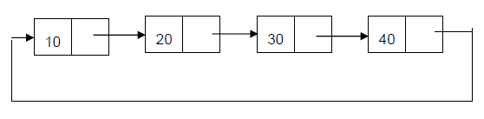
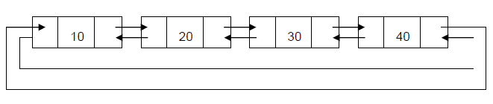
Circular linked list
The linked list where the last node points the header node is called circular linked list.
Circular singly linked list
    Forward pointer of the last node points to the first node and backward pointer of the first node points to the last node
Circular doubly linked list

Slide 50
WACP to implement circular linked list
#include<stdio.h> #include<stdlib.h>
void insertion(); void deletion(); void traverse(); void search();
struct node
{
int data;
struct node *link;
}*new,*ptr,*ptr1,*header,*last;
int ch,item,pos,i;
void main(){
header=NULL;
while(1) {
printf("\n****Menu****\n");
printf("\n 1.Insertion\n 2.Deletion\n 3.Traverse\n 4.Search\n 5.Exit\n");
printf("\nenter ur choice");
scanf("%d",&ch);
switch(ch){
case 1: insertion(); break;
case 2: deletion(); break;
case 3: traverse(); break;
case 4: search(); break;
case 5: exit(0);
default: printf("\n wrong choice\n");
}/*end of switch*/
}/*end of while*/
}/*end of main*/

Slide 51
void insertion()
{
last=ptr=header;
new=malloc(sizeof(struct node));
printf("\n enter the item to be inserted\n");
scanf("%d",&item);
new->data=item;
if(header==NULL)
{
new->link=new;
header=new;
}/*end of if*/
else
{
printf("\nEnter the place to insert the item\n");
printf("1.Start\n 2.Middle\n 3.End\n");
scanf("%d",&ch);

Slide 52
if(ch==1) {
while(last->link!=header)
last=last->link; //last node address
new->link=header;
header=new;
last->link=header;//last node points to first node
}
if(ch==2)
{
printf("Enter the position to place an item: ");
scanf("%d",&pos);
for(i=1;i<pos-1;i++)
ptr=ptr->link;
new->link=ptr->link;
ptr->link=new;
}
if(ch==3)
{
while(ptr->link!=header)
ptr=ptr->link;
new->link=header; //last node points to first node
ptr->link=new;
}//end of if
}/*end of else*/
}/*end of insertion*/

Slide 53
void deletion()
{
ptr=last=header;
if(header==NULL)
{
printf("\nThe list is empty");
}
else if(ptr->link==header)
{
printf(“\n the deleted item from the list is-> %d” ,ptr->data);
free(ptr);
header=NULL;
}
else
{
printf("\n1.Start \n2.Middle \n3.End");
printf("\nEnter the place to delete the element from list");
scanf("%d",&ch);

Slide 54
if(ch==1)
{
while(last->link!=header)
last=last->link; //last node address
printf("\nThe deleted item from the list is -> %d",ptr->data);
header=header->link;
last->link=header; //last node points to first node
free(ptr);
}
if(ch==2)
{
printf("\nEnter the position to delete the element “);
scanf("%d",&pos);
for(i=1; i<pos; i++)
{
ptr1=ptr;
ptr=ptr->link;
}
printf("\nThe deleted element is ->%d",ptr->data);
ptr1->link=ptr->link;
free(ptr);
}
if(ch==3)
{
while(ptr->link!=header)
{
ptr1=ptr;
ptr=ptr->link;
}//while
printf("\nThe deleted element from the list is ->%d", ptr->data);
ptr1->link=header; //last node points to first node
free(ptr);
}
}/*end of else*/
}/*end of deletion*/

Slide 55
void search()
{
int loc=0,f=0;
ptr=header;
printf("\nEnter the element to be searched in the list");
scanf("%d",&item);
do
{
loc++;
if(ptr->data==item)
{ f=1; break; }
ptr=ptr->link;
} while(ptr!=header);
if(f==1)
printf("\nThe element found at location %d",loc);
else
printf("\nElement not found");
}//end of search

Slide 56
void traverse()
{
int i=0;
if(header==NULL)
printf("List is empty\n");
else
{
printf("\nThe elements in the list are:");
ptr=header;
do{
printf(“ %d“,ptr->data);
ptr=ptr->link;
}while(ptr!=header);
}/*end of traverse*/

Slide 57
Representing Stack with Linked List
Disadvantage of using an array to implement a stack or queue is the wastage of space.
Implementing stacks as linked lists provides a feasibility on the number of nodes by dynamically growing stacks, as a linked list is a dynamic data structure.
The stack can grow or shrink as the program demands it to.
A variable top always points to top element of the stack.
top = NULL specifies stack is empty.

Slide 58
Example:
The following list consists of five cells, each of which holds a data object
and a link to another cell.
A variable, top, holds the address of the first cell in the list.
top
50
1500
1100
40
1800
1500
30
1200
1800
20
1400
1200
10
NULL
1400

Slide 59
/* write a c program to implement stack using linked list */
#include<stdio.h>
#include<stdlib.h>
void push(); void pop(); void display(); void count();
int ch,i,item;
struct node {
int data;
struct node *link;
}*top,*new,*ptr;
void main()
{
top=NULL;
printf("\n***Select Menu***\n");
while(1) {
printf("\n1.Push \n2.Pop \n3.Display \n4.Count 5.Exit");
printf("\n\nEnter ur choice: ");
scanf("%d",&ch);
switch(ch) {
case 1: push(); break;
case 2: pop(); break;
case 3: display(); break;
case 4: count(); break;
case 5: exit(0); break;
default: printf("\nWrong choice");
}/* end of switch */
}/* end of while */
}/* end of main */

Slide 60
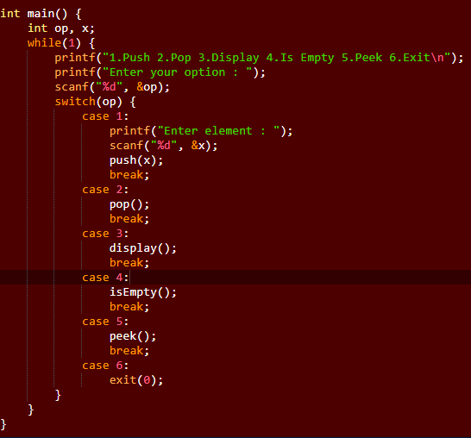

Slide 61
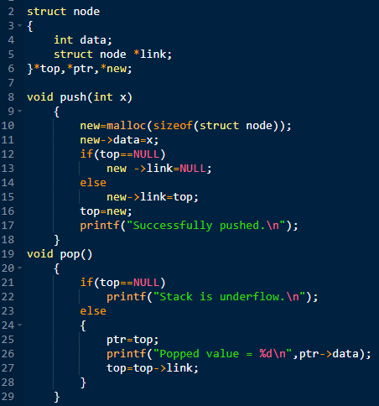

Slide 62
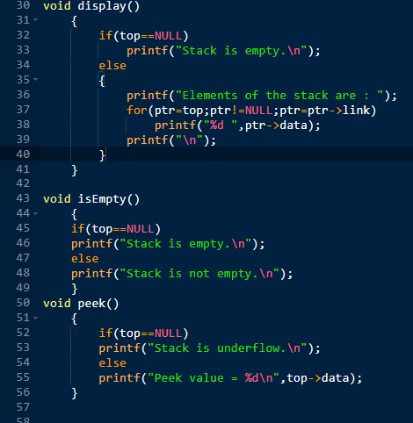

Slide 63
void push()
{
new=malloc(sizeof(struct node));
printf("\nEnter the item: ");
scanf("%d",&item);
new->data=item;
if(top = = NULL)
{
new->link=NULL;
}
else
{
new->link=top;
}
top=new;
}/* end of insertion */
void pop()
{
if(top = = NULL)
{
printf("\n\nStack is empty");
}//if
else
{
ptr=top;
printf("\n\nThe deleted element is: %d“,ptr->data);
top=top->link;
free(ptr);
}
}/* end of pop() */

Slide 64
void count()
{
int count=0;
if(top = = NULL)
printf("\nThe list is empty");
else
{
for(ptr=top; ptr!=NULL; ptr=ptr->link)
{
++count;
}
printf("\n\nThe number of elements in
the stack are: %d",count);
}/* end of count */
void display()
{
if(top = = NULL)
printf("\nThe list is empty");
else
{
printf("\nThe elements in the stact are: ");
for(ptr=top; ptr!=NULL; ptr=ptr->link)
{
printf("\n %d",ptr->data);
}// end of for
}// end of else
}/* end of display() */

Slide 65
Representing Queue with Linked List
New items are added to the end of the list.
Removing an item from the queue will be done from the front.
A pictorial representation of a queue being implemented as a linked list is given below.
The variables front points to the front item in the queue and rear points to the last item in the queue.
front
rear
10
1800
20
1200
30
1400
40
NULL
1500
1800
1200
1400

Slide 66
//write a c program to implement queue using linked list
#include<stdio.h>
#include<stdlib.h> void enqueue(); void dequeue(); void display();
int ch,i,item;
struct node {
int data;
struct node *link;
}*front,*rear,*new,*ptr;
void main() {
front=NULL;
rear=NULL;
printf("\n\n MENU");
printf("\n1.Enqueue \n2.Dequeue \n3.Display \n4.Exit");
while(1) {
printf("\nEnter your choice: ");
scanf("%d",&ch);
switch(ch) {
case 1:enqueue(); break;
case 2:dequeue(); break;
case 3:display(); break;
case 4:exit(0);
default:printf("\nwrong choice");
}/*end of switch */
}/*end of while */
}/*end of main */

Slide 67
void enqueue()
{
new=malloc(sizeof(struct node));
printf("\nenter the item");
scanf("%d",&item);
new->data=item;
new->link=NULL;
if(front==NULL)
{
front=new;
}
else
{
rear->link=new;
}
rear=new;
}/*end of enqueue */
void display()
{
if(front==NULL)
printf("\nThe list is emtpy");
else
{
for(ptr=front;ptr!=NULL;ptr=ptr->link)
printf(" %d",ptr->data);
}
}/* end of display */

Slide 68
void dequeue()
{
if(front==NULL)
printf("\nThe list is empty");
else
{
ptr=front;
printf("\nThe deleted element is: %d“,ptr->data);
if(front==rear) //List has single element
front=rear=NULL;
else
front=front->link;
free(ptr);
}
}/*end of dequeue*/

Slide 69
/* Write a c program to implement circular queue with linked list*/
#include<stdio.h> #include<stdlib.h>
int choice,i,item;
struct node {
int data;
struct node *link;
}*front,*rear,*new,*ptr1,*ptr;
main() {
front=rear=NULL;
printf("\n select menu\n");
while(1) {
printf("\n1.Enqueue \n2.Dequeue \n3.Display \n4.Exit");
printf("\nEnter ur choice: ");
scanf("%d",&choice);
switch(choice) {
case 1: enqueue(); break;
case 2: dequeue(); break;
case 3: display(); break;
case 4: exit(0);
default: printf("\nWrong choice.");
}/*end of switch*/
}/*end of while*/
}/*end of main*/

Slide 70
void enqueue()
{
new=malloc(sizeof(struct node));
printf("\nEnter the item: ");
scanf("%d",&item);
new->data=item;
if(front==NULL)
front=new;
else
rear->link=new;
rear=new;
rear->link=front;
}/*end of enqueue()*/
void dequeue()
{
if(front==NULL)
printf("\nThe list is empty");
else
{
ptr=front;
printf("\nThe deleted element is: %d“,ptr->data);
if(front==rear) //List has single element
front=rear=NULL;
else
front=front->link;
free(ptr);
}
rear->link=front;
}/*end of dequeue*/

Slide 71
void display()
{
if(front==NULL)
printf("\nThe circular list is empty.");
else
{
printf("\nElements in the list are: ");
ptr=front;
do{
printf(" %d",ptr->data);
ptr=ptr->link;
}while(ptr!=front);
}/*end of else*/
}/*end of display*/

